Slide 1
Real-time static gesture detection using Machine Learning
From: Sandipgiri Goswami
Supervisor : Dr.Kalpdurm Passi

Slide 2
Contents
About American Sign Language (ASL)
Objective
Dataset
Hardware Configurations
Software Used
Image Processing Steps
Machine Learning approach
Result
Feature work

Slide 3
About Language:
The method of human communication, either spoken or written, consisting of use of words in structured and conventional way.
There are roughly 6,500 spoken languages in the world today.
English as a global language.
With more than 350 million people around the world speaking English as a first language and more than 430 million speaking it as a second language.

Slide 4
About Sign Language
Sign Language is a language which uses to convey a message by hand movements, facial expression and body language to communication.
It is mainly used by deaf and people who can hear but cannot speak.
Sometime family member and relatives must learn sign language to interpreters which enable deaf and wider communities to communicate with each other.
In fact, there are somewhere between 138 and 300 different types of sign language used throughout the world today

Slide 5
Different Sign Language in the Americas
North America | Central America | South America
•American Sign Language •Inuit Sign Language •Quebec Sign Language •Puerto Rican Sign Language | •Costa Rican Sign Language •Guatemalan Sign Language •Honduras Sign Language •Mayan Sign Language •Mexican Sign Language •Nicaraguan Sign Language •Panamanian Sign Language •Salvadorian Sign Language •Tijuana Sign Language | •Argentine Sign Language •Bolivian Sign Language •Brazilian Sign Language •Chilean Sign Language •Colombian Sign Language •Ecaudorian Sign Language •Paraguayan Sign Language •Peruvian Sign Language •Uruaguayan Sign Language •Venezuelan Sign Language

Slide 6
Misunderstandings about Sign Language
Similar to spoken language.
Unique language all over the world.
Easy to learn.
Easy to communicate.

Slide 7
About American Sign Language(ASL)
Implemented from French sign language.
Introduced by Thomas Hopins in the United States.
ASL is similar to French sign language.
A variation of American Sign Language also exits.

Slide 8
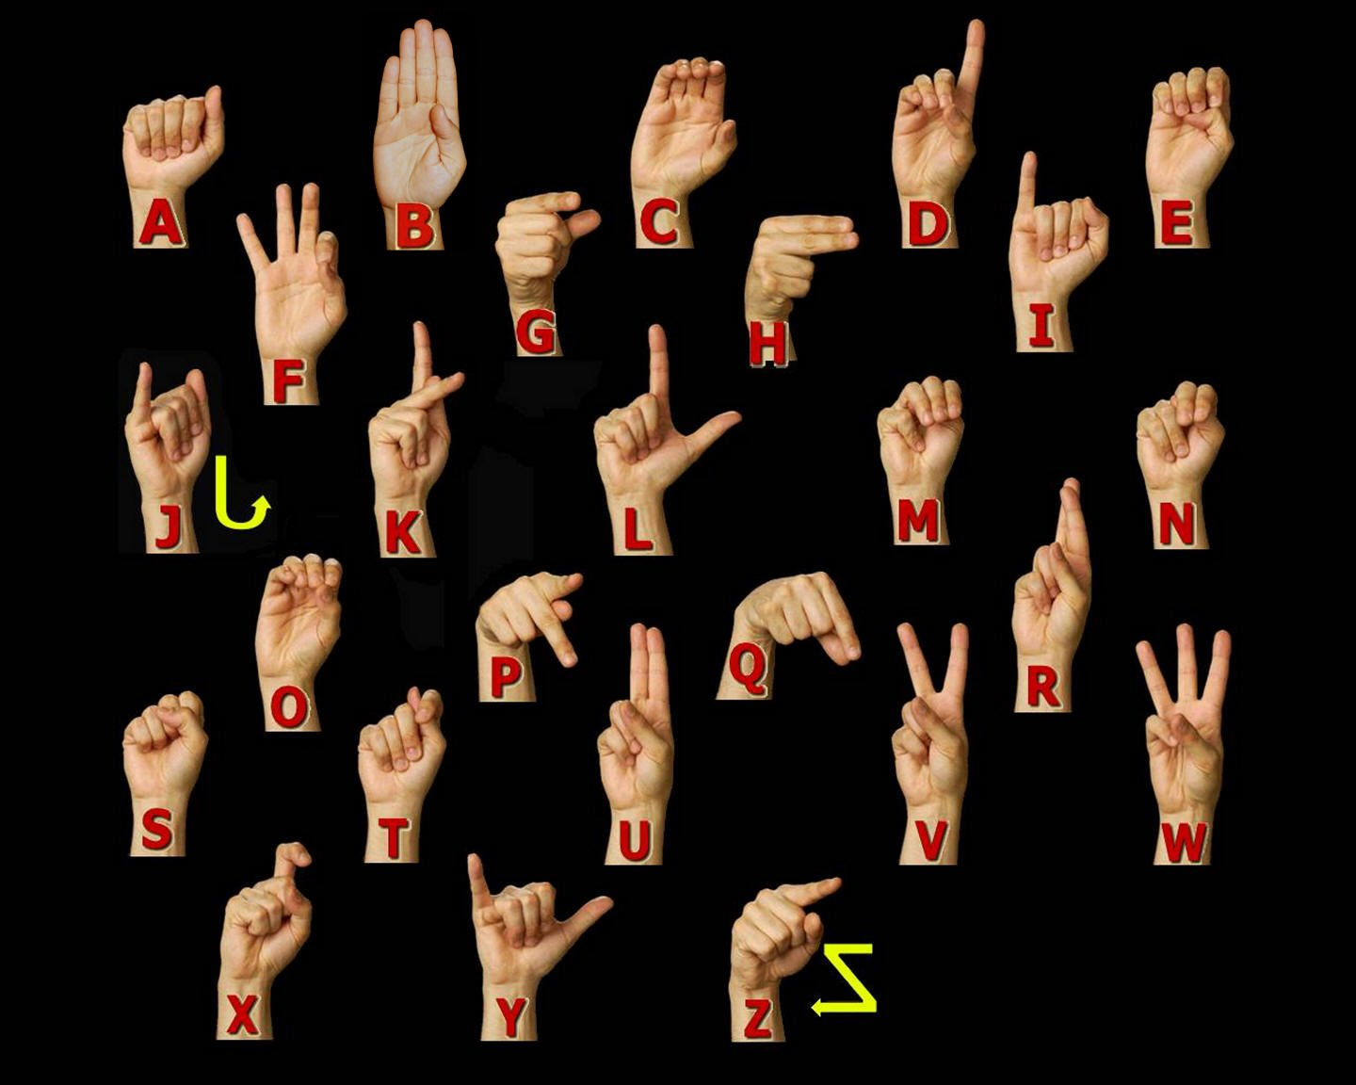
ASL Manual Alphabet

Slide 9
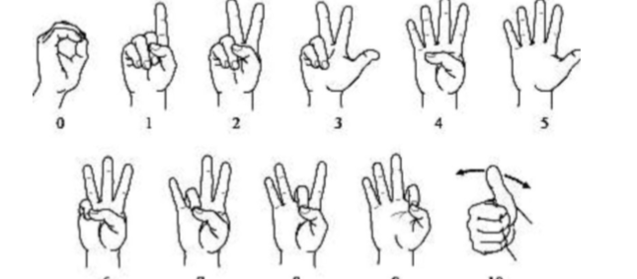
American Sign language numbers

Slide 10
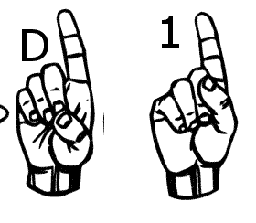
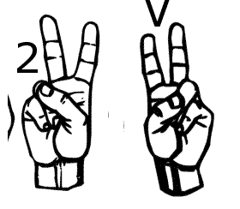
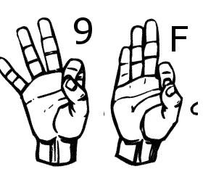
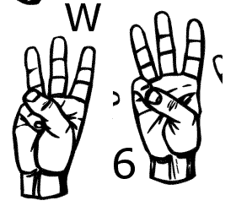
Similar Sign Gesture

Slide 11
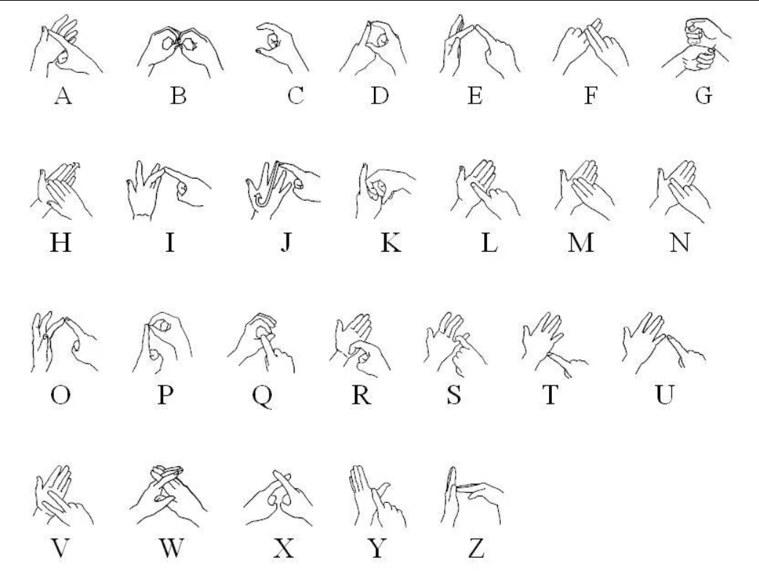
British Sign Language

Slide 12
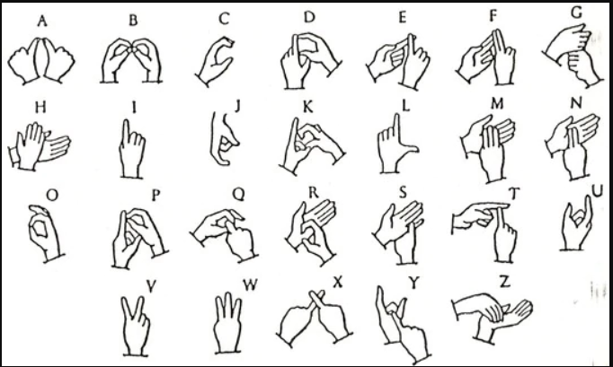
India Sign Language

Slide 13
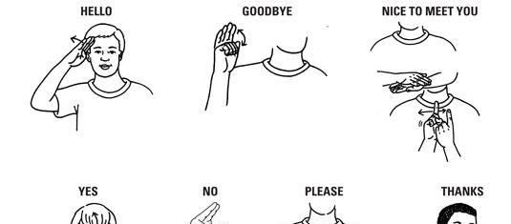
A few words in Sign language

Slide 14
Statistics about sign language use in Canada
American Sign Language | 2,485
Quebec Sign Language | 730

Slide 15
Statics about Knowledge of Sign Languages
American Sign Language | 11,110
Quebec Sign Language | 730

Slide 16
Objective:
My thesis main objective to help the deaf community to increases their self-esteem and IQ level and improve their communication skill. A student who is deaf or has a deaf parent or has a close relative with deaf individual will learn by themselves about sign language alphabets and numbers.
Deaf community will learn their first step toward to American sign language. Although the correct usage of sign gesture plays a very important part in effective communication.
A deaf student also encouraged to establish a connection to the deaf community and to carry their new knowledge and skill beyond the classroom and into the community at large.

Slide 17
Dataset and variables:
I have created my own data set. This dataset was a collection of 36 which contain A to Z alphabet and 0 to 9 numbers digit.
In my dataset consist of A to Z alphabet and 0 to 9 numbers where I have used right hand to capture 1200 images for specific alphabet and numbers.
After that, I implement code which converts flip image to the right to the left-hand image.
The height and width ratios vary significantly but average approximately 50X50 pixel.
The dataset contains over 84,600 images in grayscale color. Additionally, People who want to add their images to this dataset than they can add.

Slide 18






Dataset Sample
S | A | N | D | I | P

Slide 19
Dataset Description and Image property
Property | Description
Alphabets | A to Z
Numbers | 0 to 9
Color | Gray Scale
Dimensions | 50x50
Height | 50 pixels
Width | 50 pixels

Slide 20
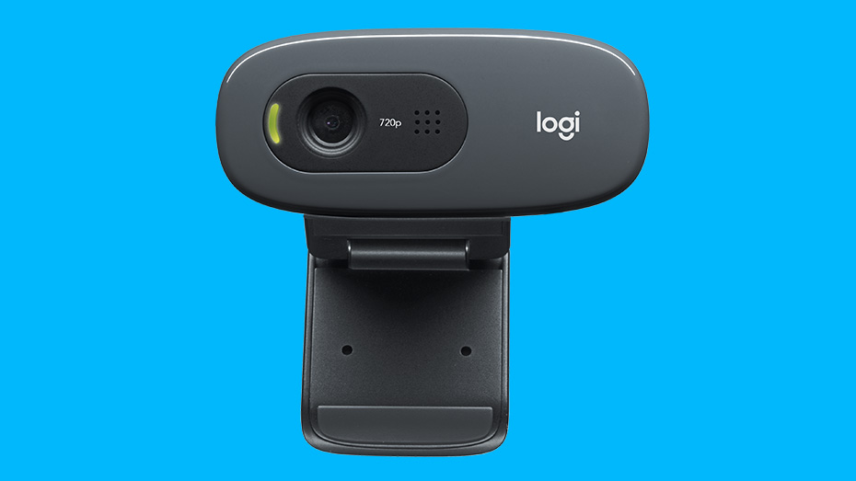
Hardware Configurations
GPU | GeForce GTX 1080 4GB
CPU | Intel(R) Core(TM) i7-8550 CPU @ 2.00GHz
Memory | DIMM 1333MHz 8GB

Slide 21
Software
Keras | 2.04
Tensor flow | 1.1.0
Python | 3.53
Operating System | Window 10
Open CV | 2.0

Slide 22
Software Used
Python
Tensor flow
Keras
OpenCV (Open Source Computer Vision Library)

Slide 23
Different software library
NumPy
Matplotlib
Pickle

Slide 24
Image Processing
A general explanation of computer vision in image processing can be brief in the following steps:
Image capture - Image is captured using a camera or similar device and digitized.
Pre-processing – A captured image is modified to highlight important features such as noise reduction, contrast normalization etc.
Segmentation detection - Selection of region of interest like edges, similar surfaces.
Description – Feature extraction of radiometric, photometric descriptors and so on.
Classification - Some means to categorize the object.
Notes:
A Gaussian filter is a linear filter. It's usually used to blur the image or to reduce noise. ... The Gaussian filter alone will blur edges and reduce contrast. In blurring, we simple blur an image. An image looks more sharp or more detailed if we are able to perceive all the objects and their shapes correctly in it. ... This shape of an object is due to its edges.

Slide 25
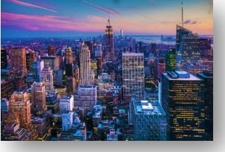
Color Image

Slide 26
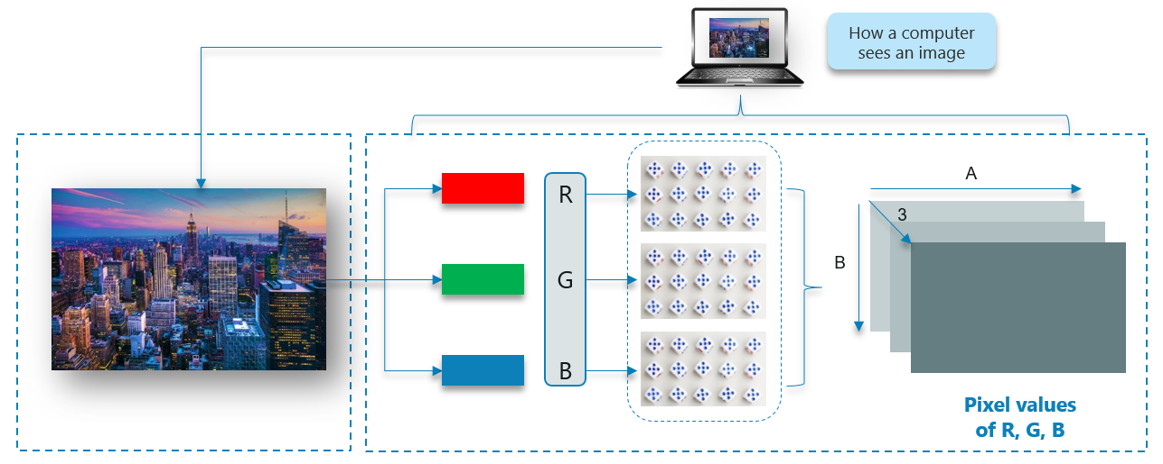
How Does A Computer Read an Image?

Slide 27
Gray Scale image

Slide 28
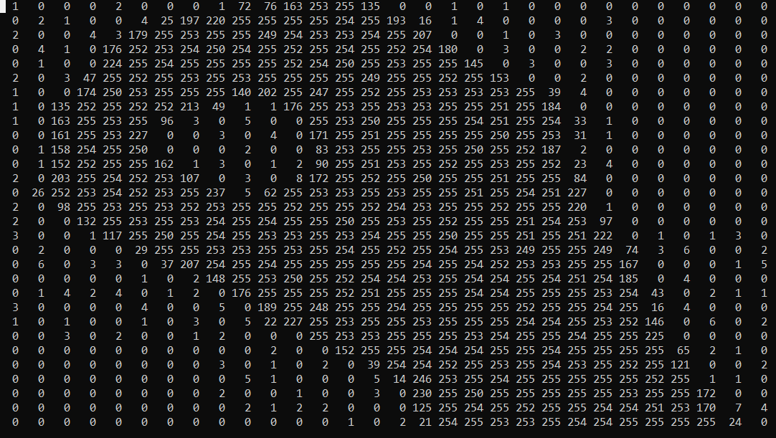
Gray scale image to 2D matrix

Slide 29
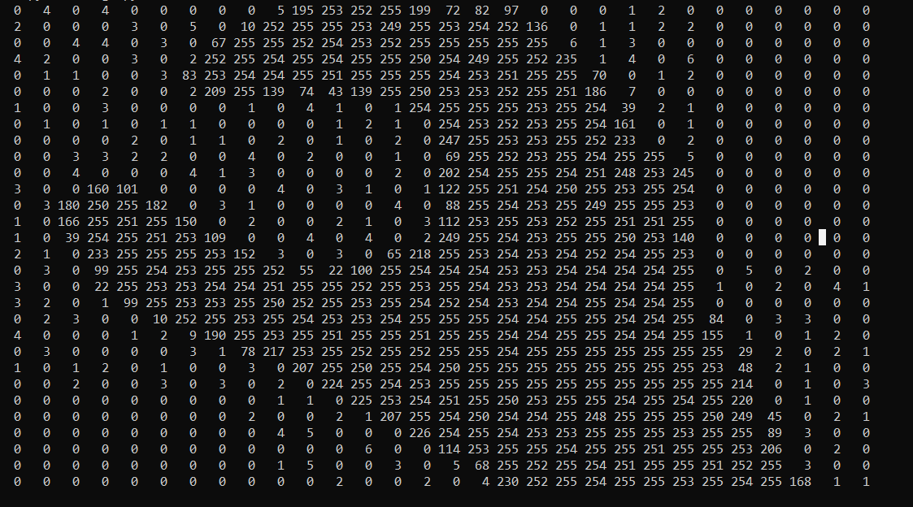
Gray scale image to 2D matrix

Slide 30
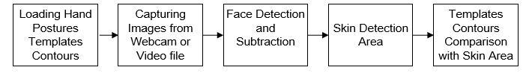
Hand posture detection steps

Slide 31
My Approach for Hand Detection
Skin Detection
Contour Comparisons

Slide 32
Machine Learning Approach
Unsupervised Learning
Supervised Learning

Slide 33
Unsupervised Learning
In the unsupervised learning method, the model is trained by detecting new data and take out patterns in the data without being instructed on what they are.
The model can learn from data without supervision.
This means that there is no need for input data to be explained.
Required smaller time and resource's to deploy.
The mainstream of unsupervised learning procedures belongs to a group called clustering algorithms.

Slide 34
Unsupervised learning models methods:
K-means -clustering model
Self Organizing Maps (SOMs)
Principal Component Analysis (PCA) - dimensionality reduction

Slide 35
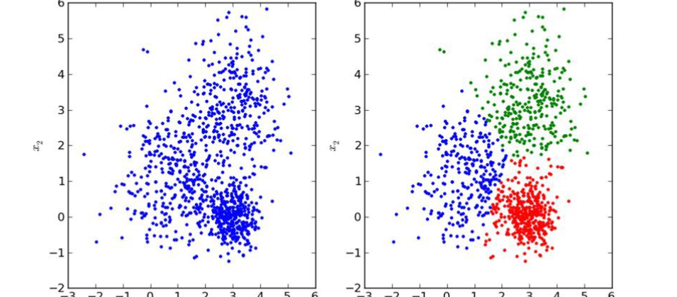
Unsupervised Learning Image

Slide 36
Supervised Learning
The supervised learning method is more commonly used.
This method needs training data with a specific format. Each instance must have assigned label.
Supervised learning problems can be further grouped into regression and classification problems.
Classification: A classification problem is when the output variable is a category, such as “red” or “blue” or “disease” and “no disease”.
Regression: A regression problem is when the output variable is a real value, such as “dollars” or “weight”.
The training process of supervised learning as follows
First, the training data are fed into the model to produce estimates of output.
This estimate is compared to the assigned label of the training data in order to evaluate model error.
Based on this error the learning algorithm alters model’s parameters in order to reduce it.

Slide 37
Supervised learning models methods:
Some popular examples of supervised machine learning algorithms are:
Linear regression for regression problems.
Random forest for classification and regression problems.
Support vector machines for classification problems.

Slide 38
Structure of Machine Learning Algorithm
Dataset description
Model
Cost function
Optimization technique

Slide 39

Dataset Description and Model
$x_{i}^{T}=\left[x_{1},x_{2},…,x_{p}\right],$ (Dataset)
$θ^{T}=\left[θ_{1},θ_{2},…,θ_{p}\right]$, (Model)
${\hat{y}}_{i}$=$\sum_{j=1}^{p}{x_{ij}}θ_{j}$

Slide 40
Neural Network Architecture
Single layer feed forward network.
Learning in feed-forward networks use for supervised learning, in which pairs of input and output values are supplies into the network for many loops, so that the network trained the interconnection between the input and output.
Multilayer Feed Forward Network
Backpropagation is a method used in artificial neural networks to calculate a gradient that is needed in the calculation of the weights to be used in the network
Self Organizing Map(Unsupervised Learning)

Slide 41
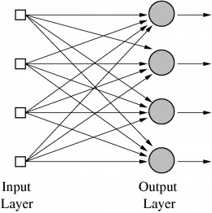
Single Layer feed forward network

Slide 42
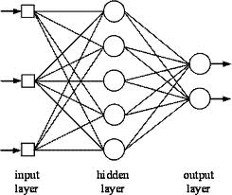
Multilayer feed forward network

Slide 43
Multilayer feed forward network
Input layer-It contains those units (Artificial neurons) which get contribution from the outside world on which system will learn, perceive about or generally process.
Output layer — It contains units that react to the data about how it’s learned any task.
Hidden layer — These layers are in between input and output layers. The main objective of the hidden layer is to transfer the input into something that output unit can use and analyse.
Neural networks are fully connected when every node in a hidden layer is fully connected to every node in its previous layer(input) and to the next layer (output) layer.

Slide 44
Model Structure
Inputs
Weights
Bias
Pooling Layer
Activation Function
Fully Connected Layer
Dropout
Flatten

Slide 45
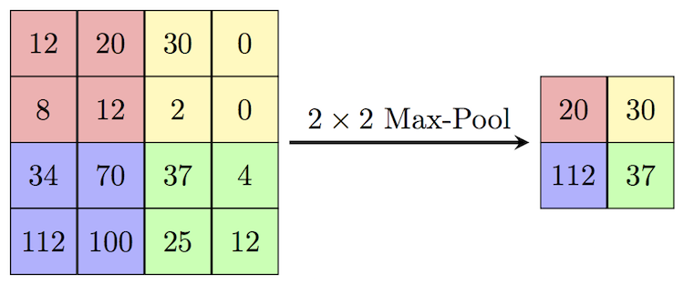
Max pooling layer

Slide 46
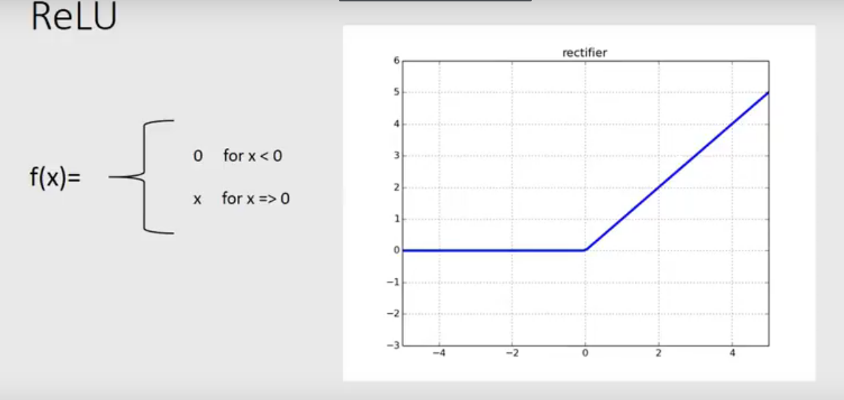
Activation Function

Slide 47
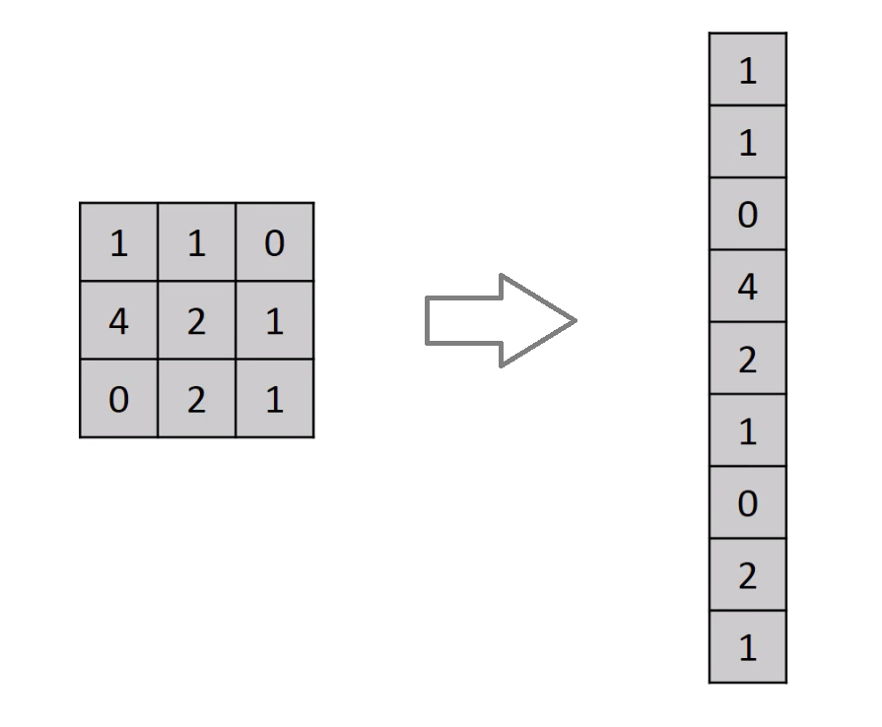
Flatten Layer

Slide 48
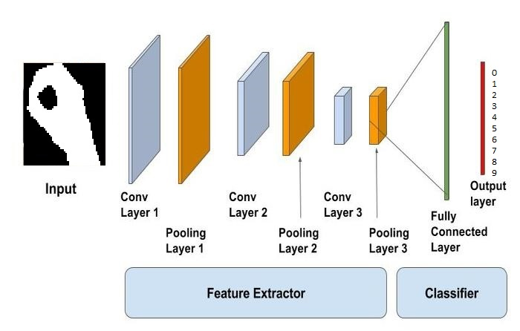

Slide 49
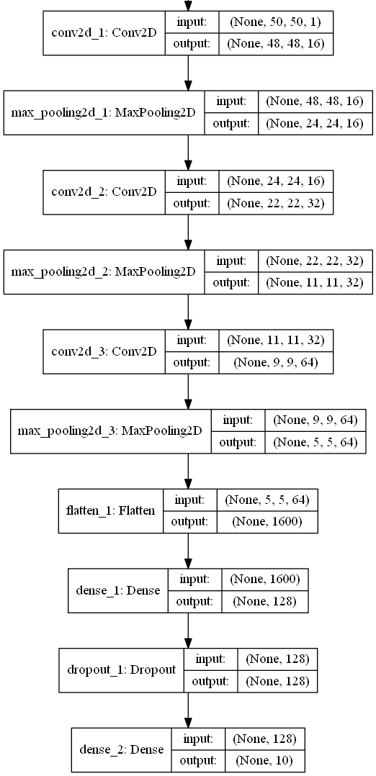
CNN Architecture

Slide 50
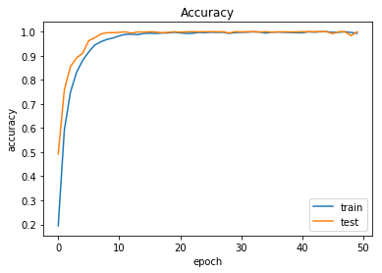
Result about alphabets

Slide 51
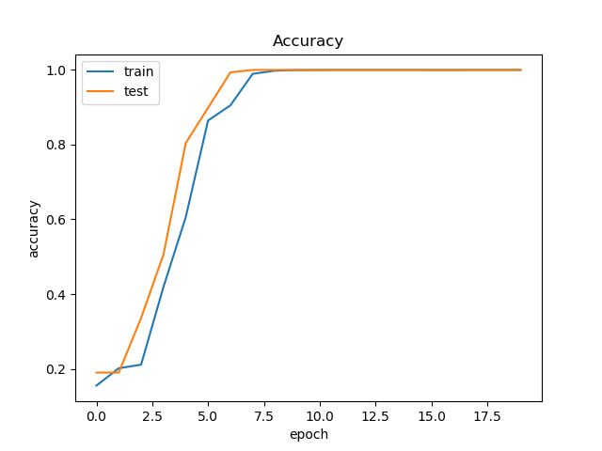
Result about digits

Slide 52

Confusion matrix
Recall =$\frac{true positives}{true positives+false negatives}$
Precision =$\frac{true positives}{true positives+false positives}$

Slide 53
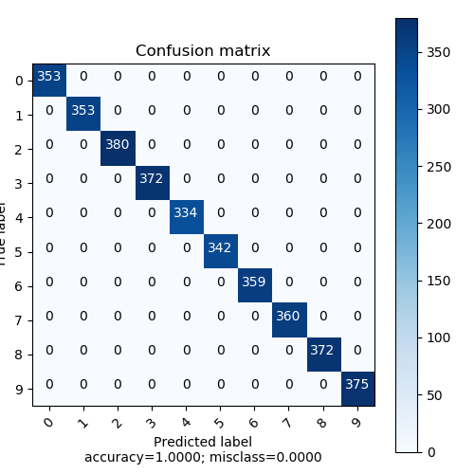
Confusion matrix for 0 to 9 digits

Slide 54
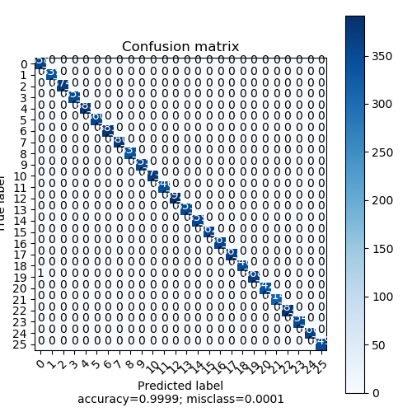
Confusion matrix for A to Z alphabets

Slide 55
Future work
Dynamic Sign Gesture Recognition
Sign Gesture Recognition from a video
Apply to 3 Dimension technique
Add more gesture in the dataset

Slide 56
Thank you

